Slide 1

Volumetric Printing by Reverse
Tomographic Projections
Doctoral Course
MICRO-722
3D printing with Light
Prof. Christophe Moser
Prof. Demetri Psaltis

Slide 2
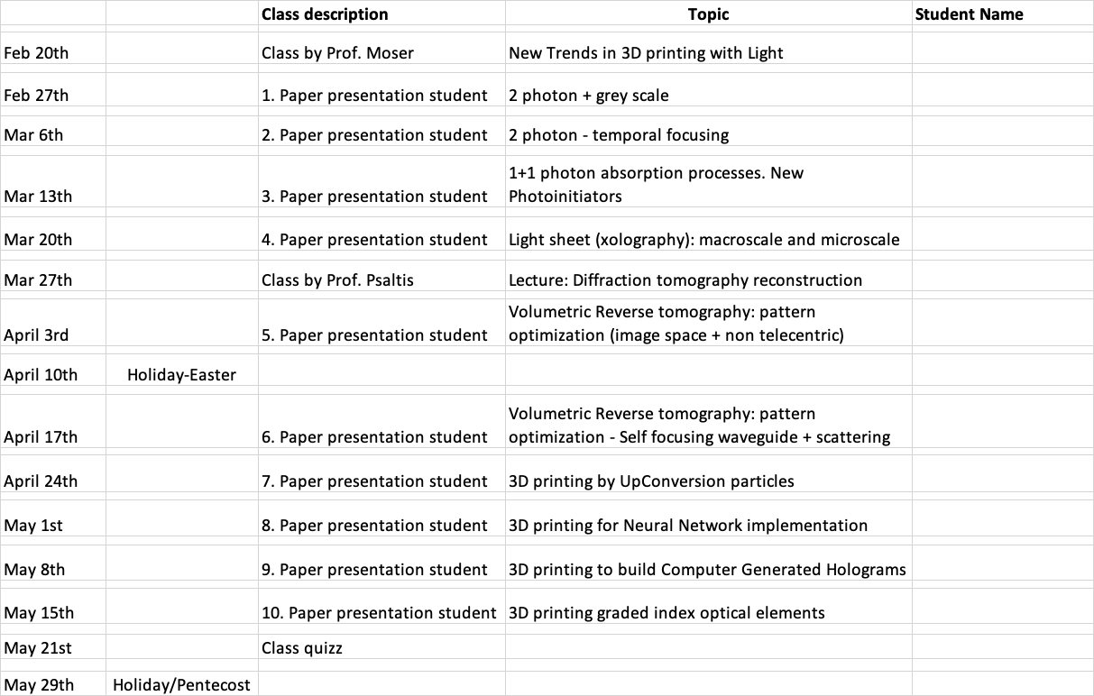
“methods”
“applications”

Slide 3

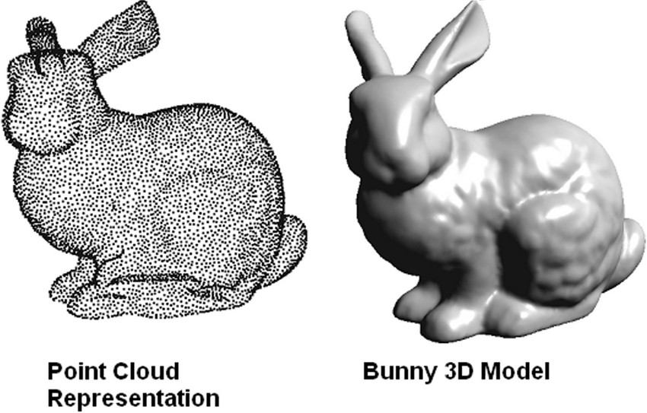

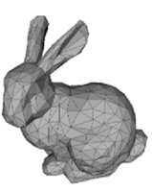
From imaging to printing objects
Optical Imaging
light
object
camera
Final Image
The goal is different, the problem is reversed, physics is the same
Printing with light
object
camera
Target Object
light

Slide 4
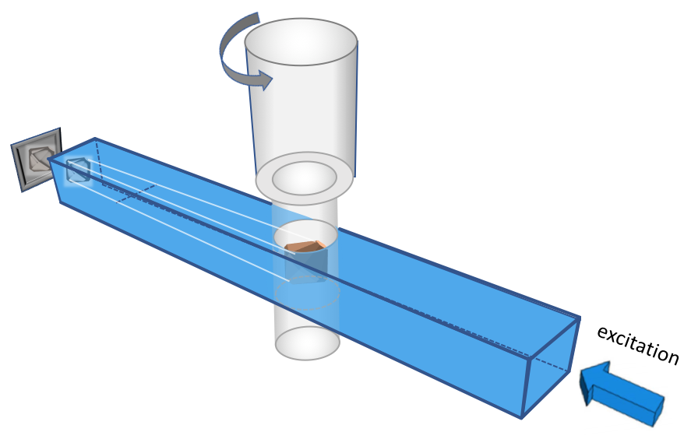
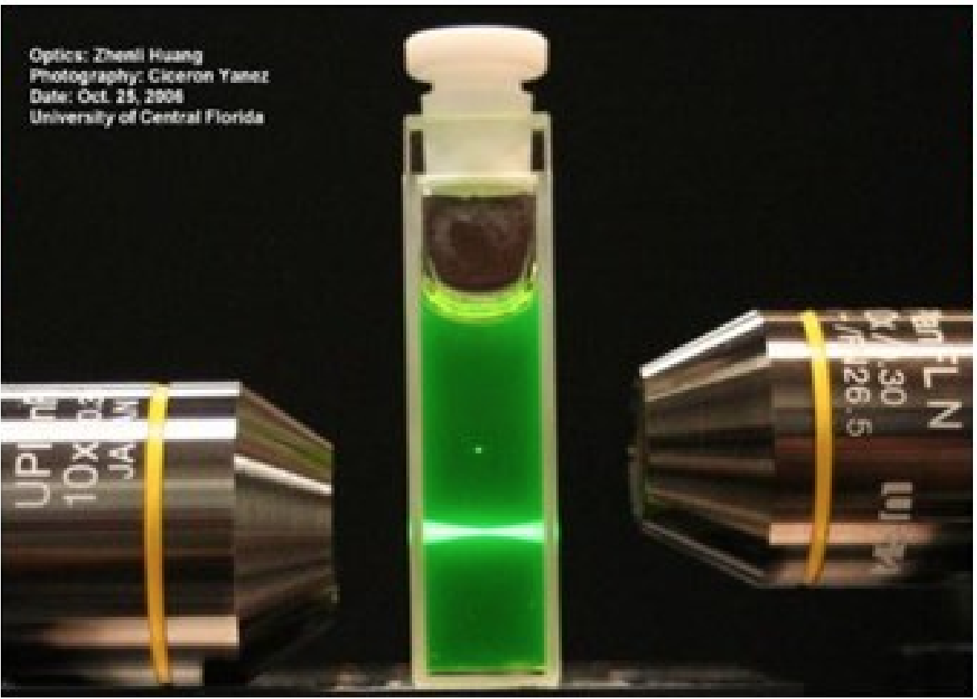
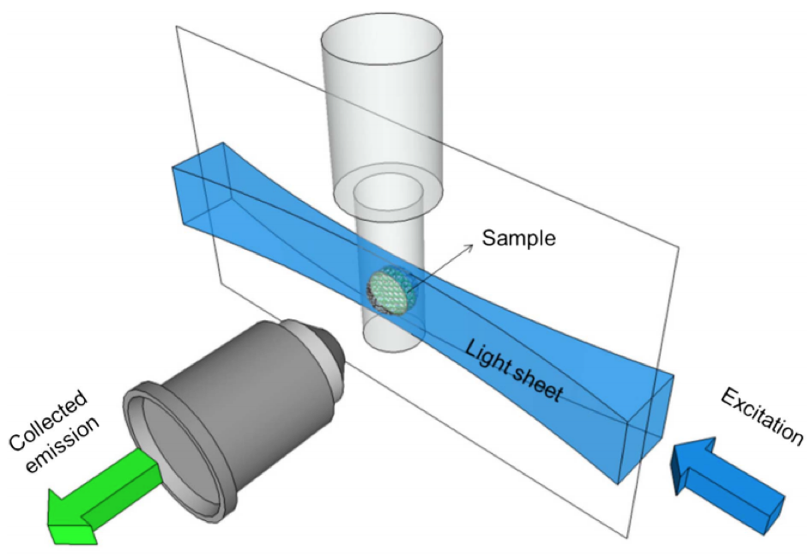
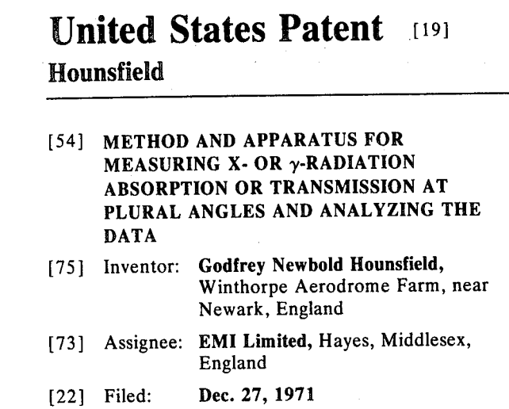
From imaging…….
2 Photon imaging
Light Sheet
Tomography
2 photon
1 photon
Denk W., Strickler J., Webb W.
Two-Photon Laser Scanning Fluorescence Microscopy
Science, 248, 4951, 1990
Voie A.H, Burns D.H, Spelman F.A
Orthogonal-plane fluorescence optical sectioning:
Three-dimensional imaging of macroscopic
biological specimens, Journal of Microscopy, 1993
Notes:
Light scattering considerably impacts print fidelity:
Global loss of resolution
Presence (respectively absence) of unwanted (respectively wanted) parts

Slide 5
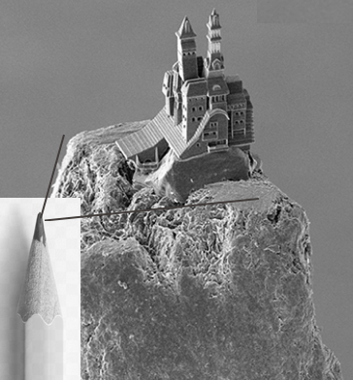
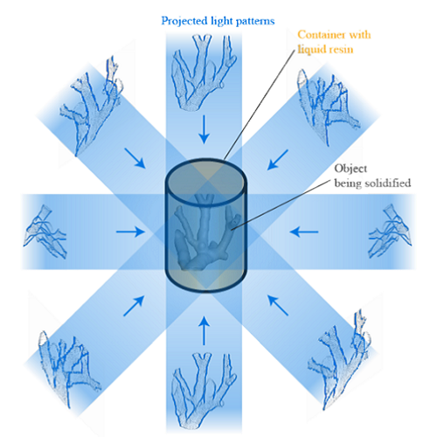
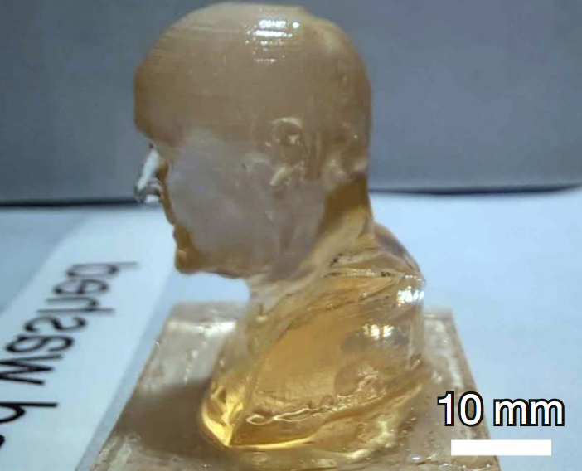
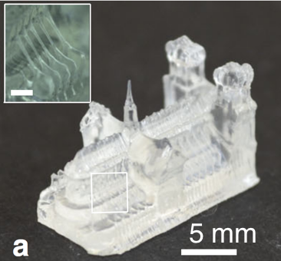
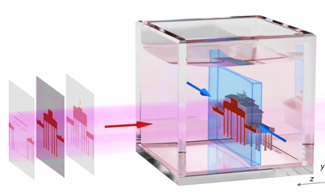
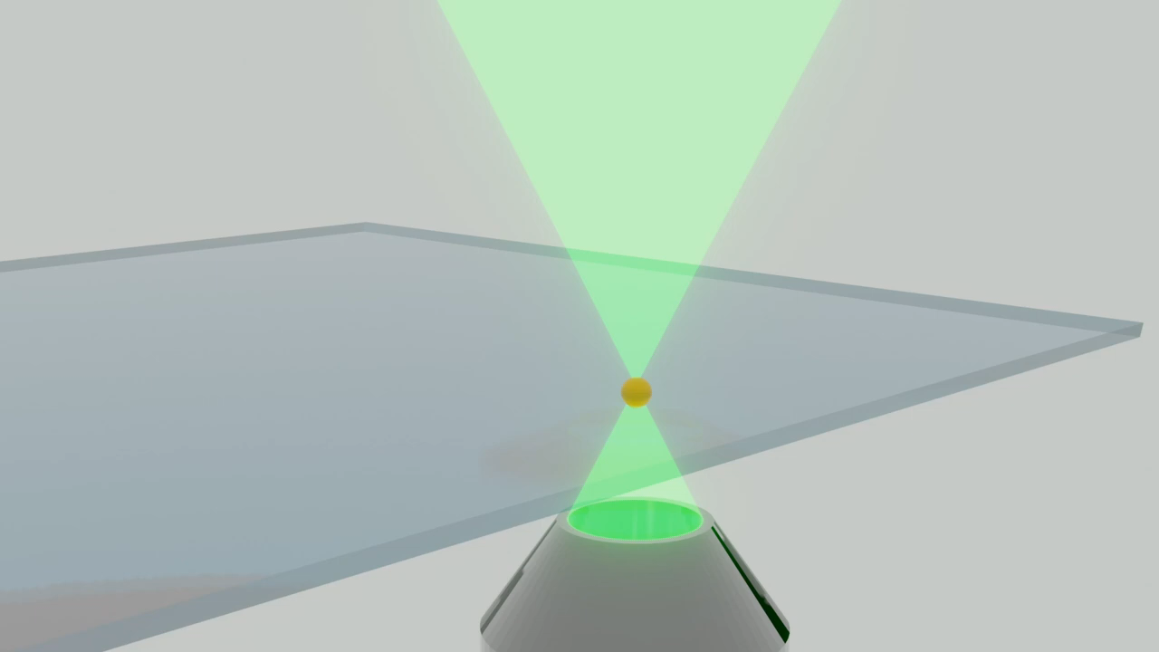
….to printing objects
2 Photon printing
Xolography
Tomographic Printing
Maruo S., O. Nakamura, Kawata S.,
"Three-dimensional microfabrication with
two-photon-absorbed photopolymerization,"
Opt. Lett. 22, 132-134 (1997)
Regehly et al. 2020. Xolography for linear volumetric 3D printing. Nature, 88, 620–624 (2020)
Bernal, et al., Volumetric bioprinting of complex living‐tissue constructs within seconds. Adv. Mat. (2019)
Loterie, et al.. High-resolution tomographic volumetric additive manufacturing. Nat Com. (2020)
Kelly, et al.. Volumetric additive manufacturing via tomographic reconstruction. Science (2019)
Notes:
Kawata
Hecht
Taylor

Slide 6
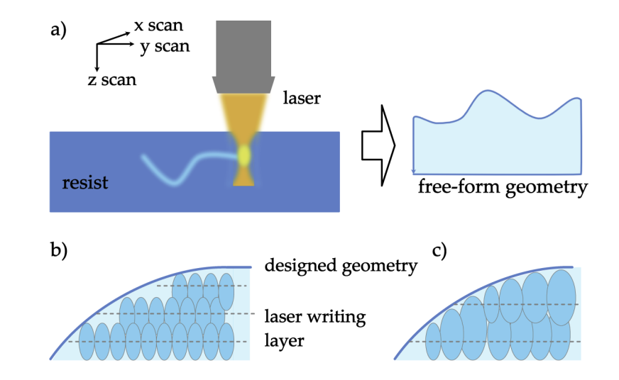
2 photon + power control = “Greyscale Lithography”

Slide 7
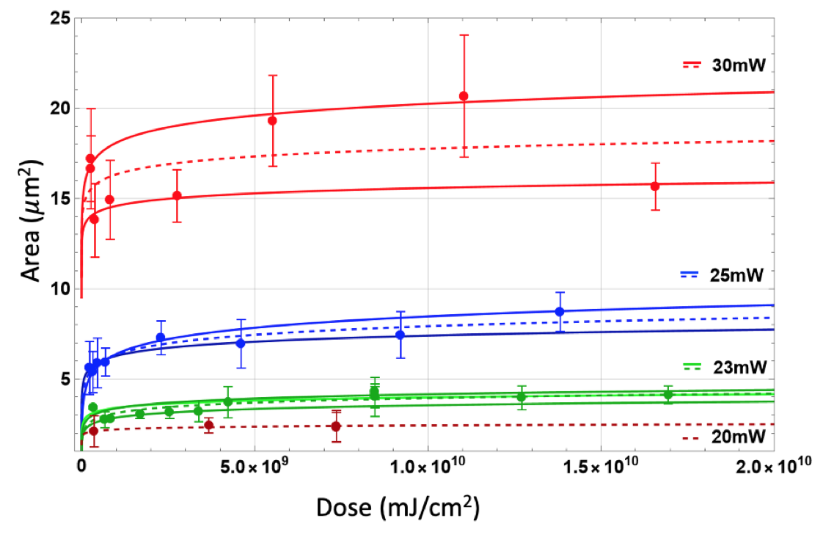

Slide 8
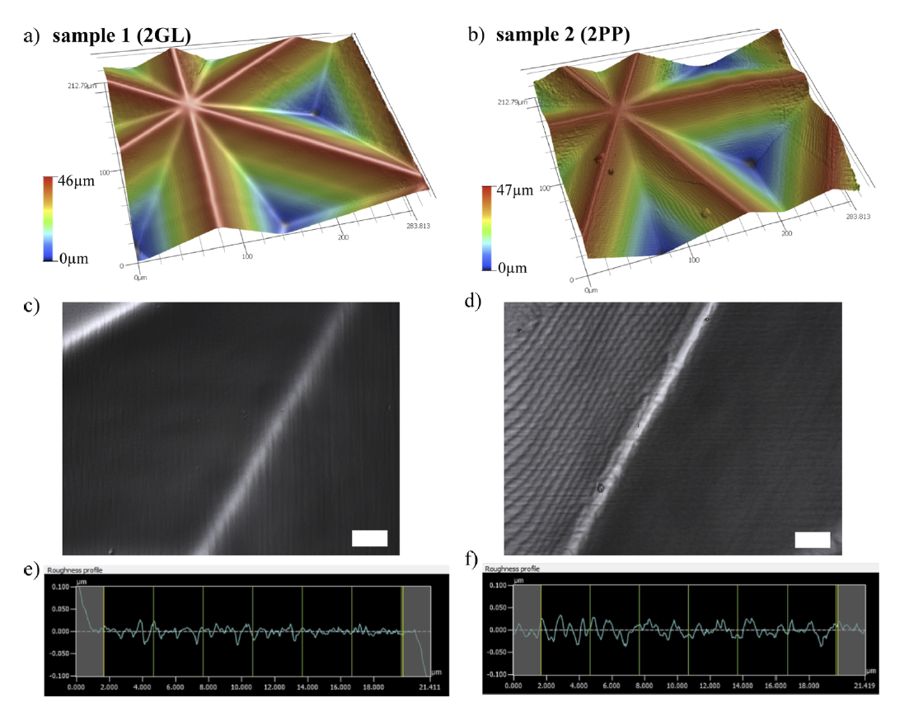
x 5

Slide 9
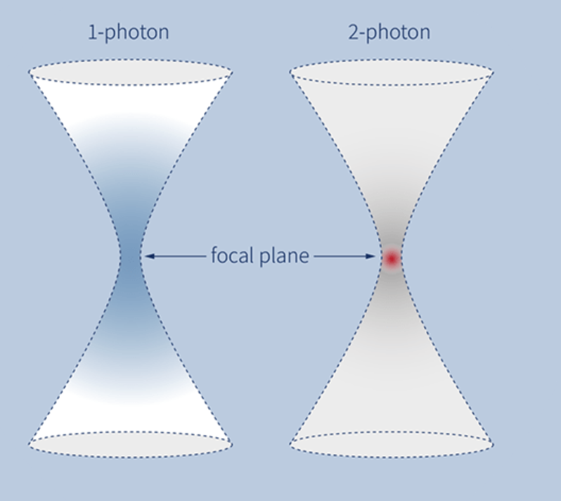
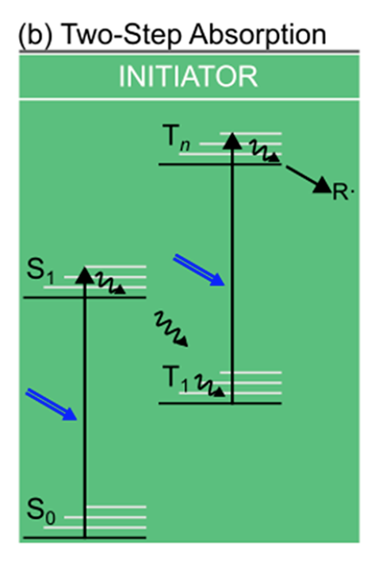

Slide 10
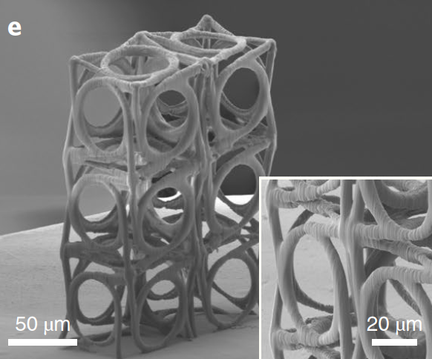
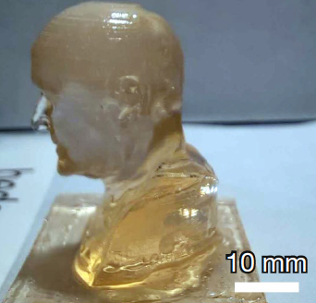
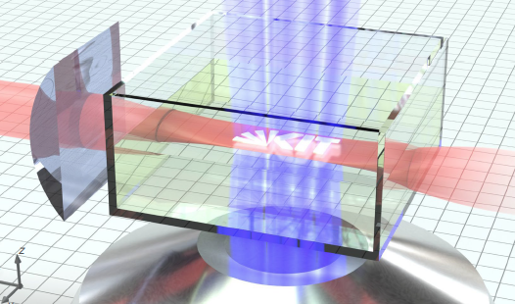
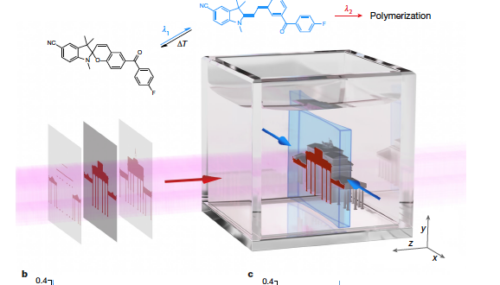
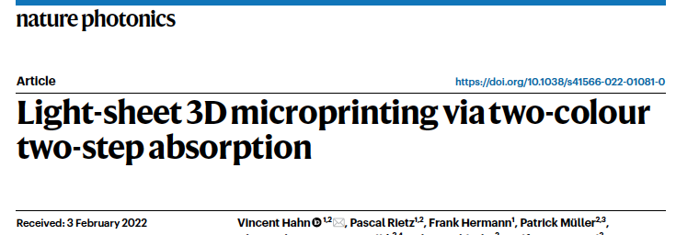
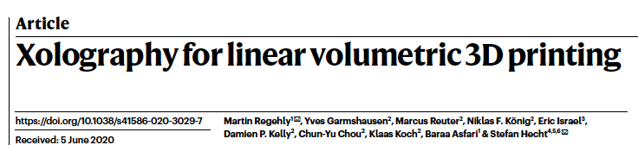
MICRO
MACRO

Slide 11
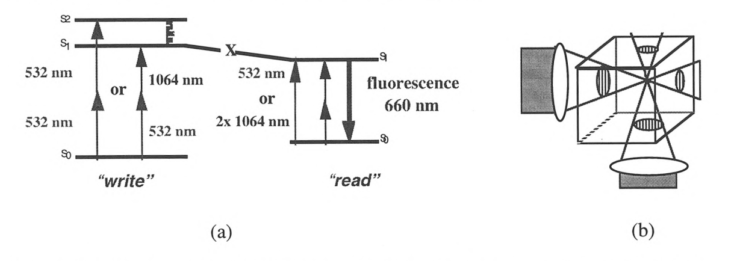
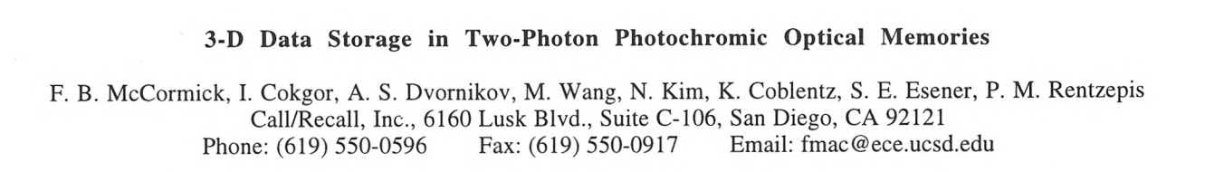
…actually this was done …25 years ago…

Slide 12
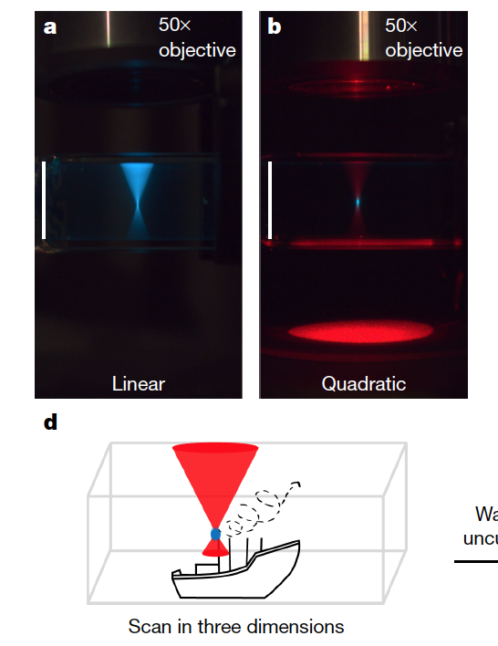
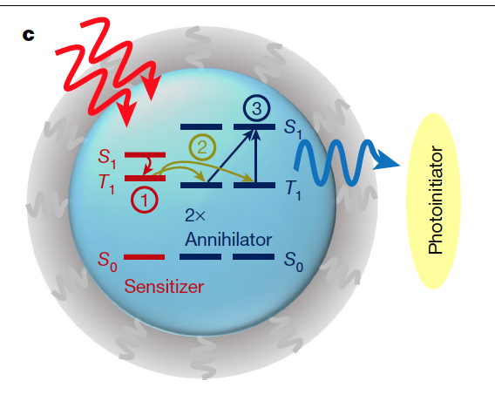
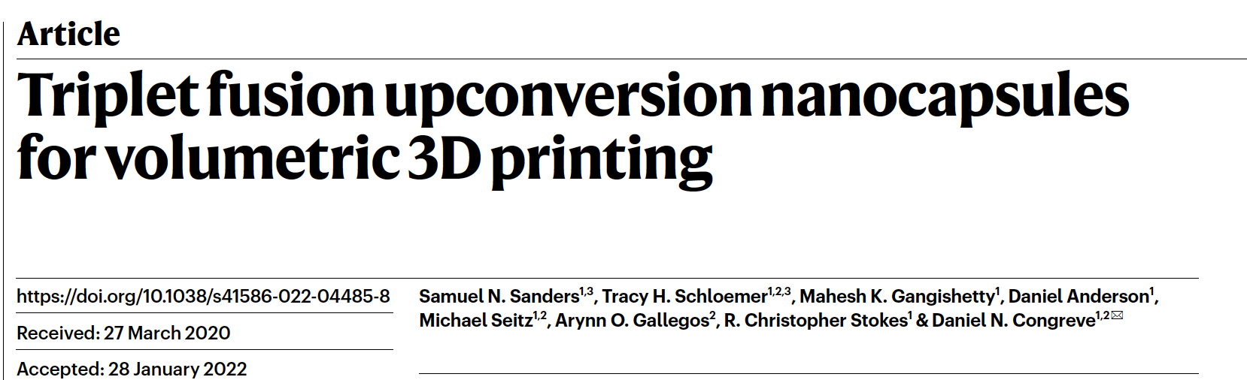
UpConversion

Slide 13
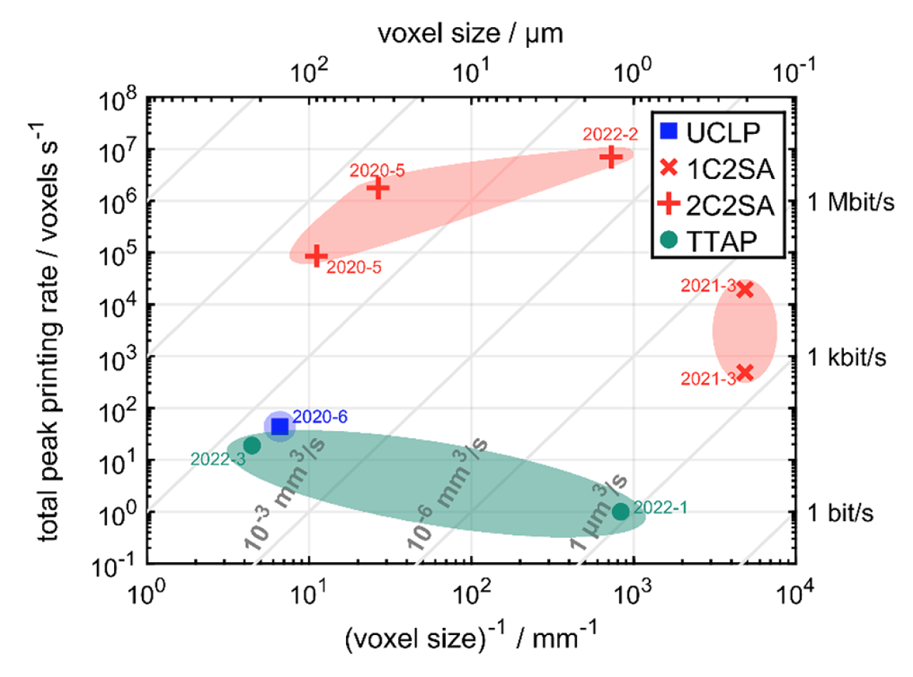
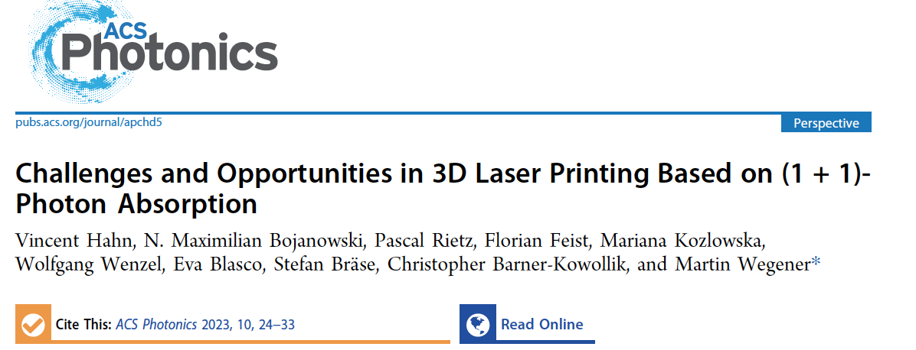

Slide 14
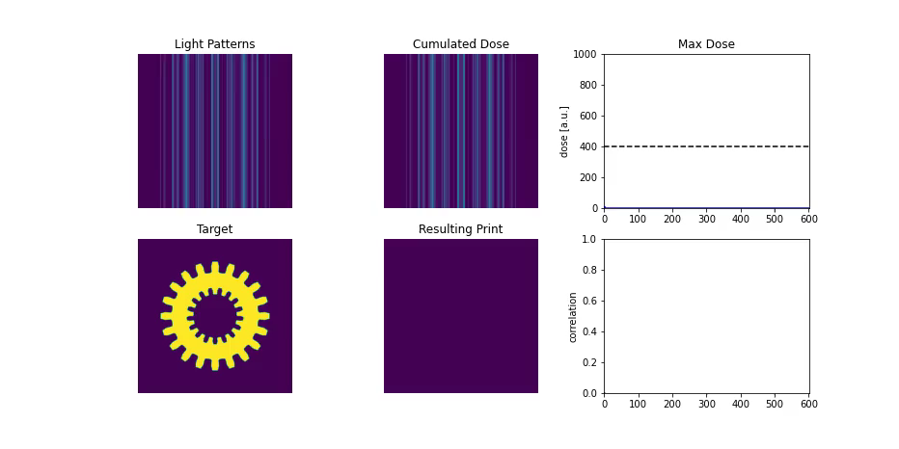
Reverse tomography for 3D printing
Kelly B.E et al. Volumetric additive manufacturing via tomographic reconstruction, Science , 2019
Bernal PN et. al. Volumetric bioprinting of complex living‐tissue constructs within seconds, Adv Materials, 2019

Slide 15
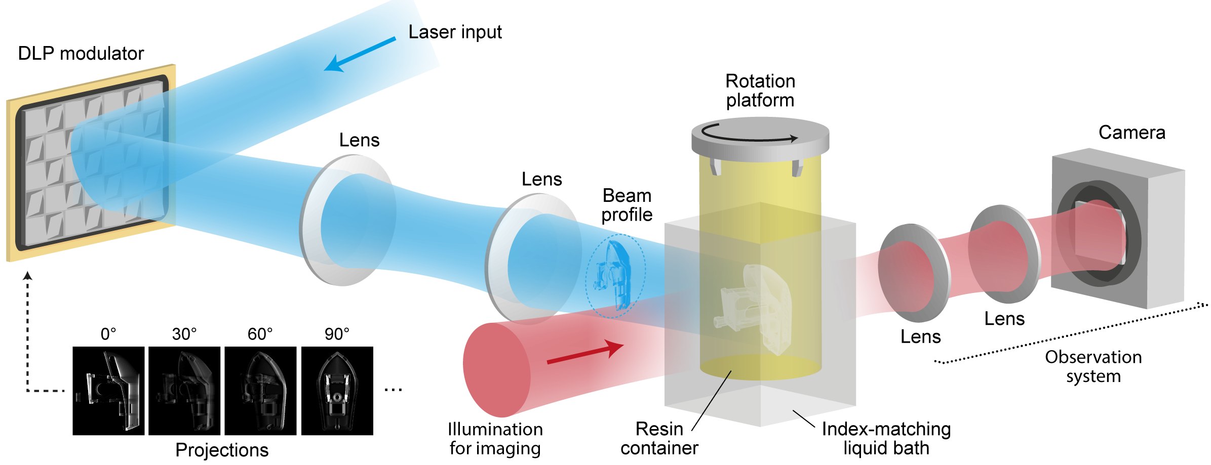
Reverse tomography for 3D printing
Delrot P, Loterie D. , Moser C. . High resolution volumetric additive manufacturing, Nat. Comm.,11,852 , 2020

Slide 16
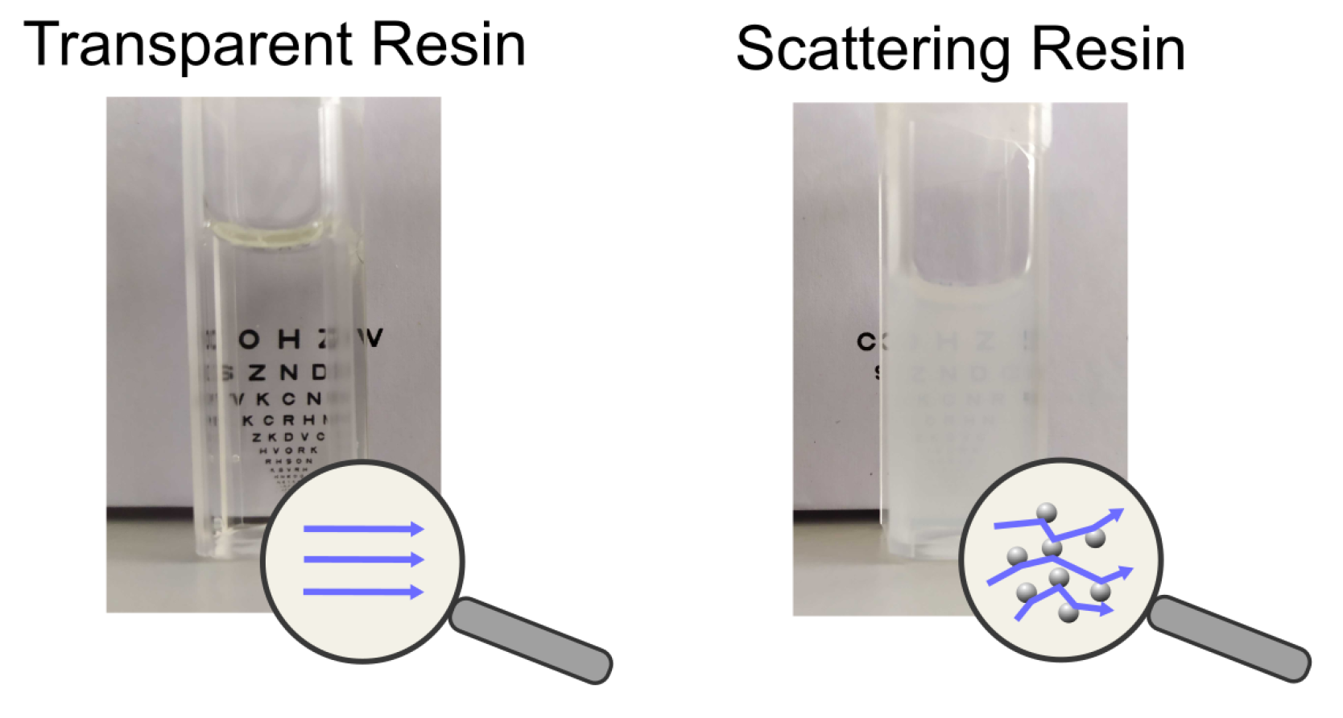
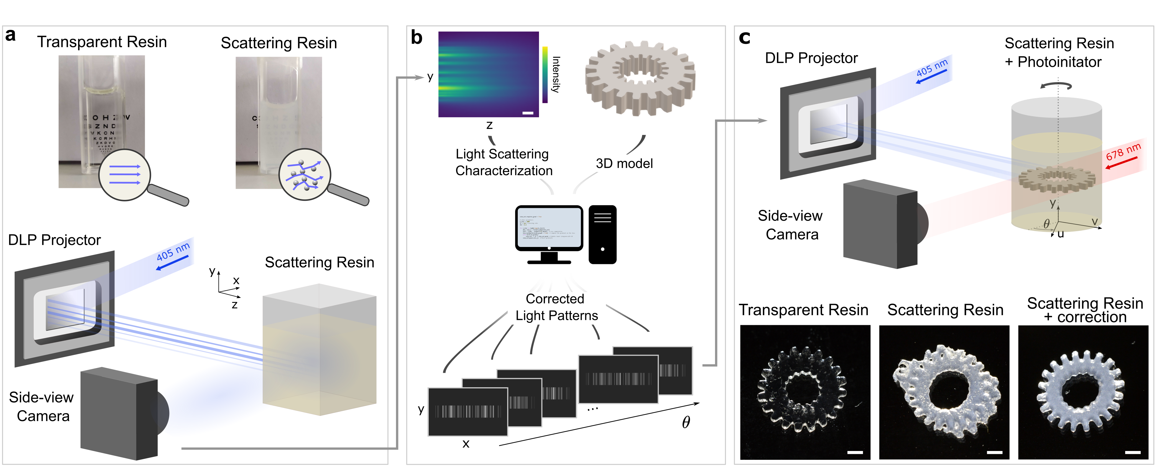
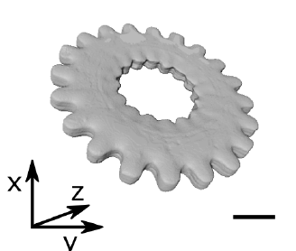
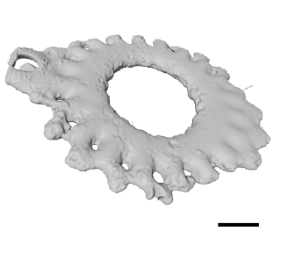
Scattering
Transparent
Scattering.

Slide 17
